Slide 1

Where do E. colis get the PUF to survive in the bladder?
More insight into putative virulence factors (PUFs)

Slide 2

Low & high virulence definition
To define the difference between low and high virulence we will conduct WGS on a selection of the cultured E. coli.
The different identified (virulence) genes and combination of (virulence) genes will be analyzed with a multiple regression analyses and/or a principle component analysis.
The goal is to identify (sets of) virulence genes within the genome of the cultured E. coli from NH residents with UTI which could be considered as “high virulence”, while the absence of these (sets of ) virulence genes could be used to define “low virulence”.
The exact combination and threshold for “high virulence” has yet to be defined by a workgroup consisting of medical microbiologists and infectiologists based on analyses of the study data and review of the literature

Slide 3
Urine
Urine is unique from a microbial perspective and its chemical makeup, distinct from all other bodily fluids
Urine has a low pH and a high osmolality due to the presence of salts and urea
The peptides, proteins, and organic acids present in urine may be metabolized by microbes
Urine is dynamic in flow rate and composition, which changes subject to diet, age, gender and health status, and disease
Using → Synthetic human urine (SHU)
Notes:
Front. Cell. Infect. Microbiol., 08 February 2016
Sec. Molecular Bacterial Pathogenesis
Volume 6 - 2016 | https://doi.org/10.3389/fcimb.2016.00014

Slide 4
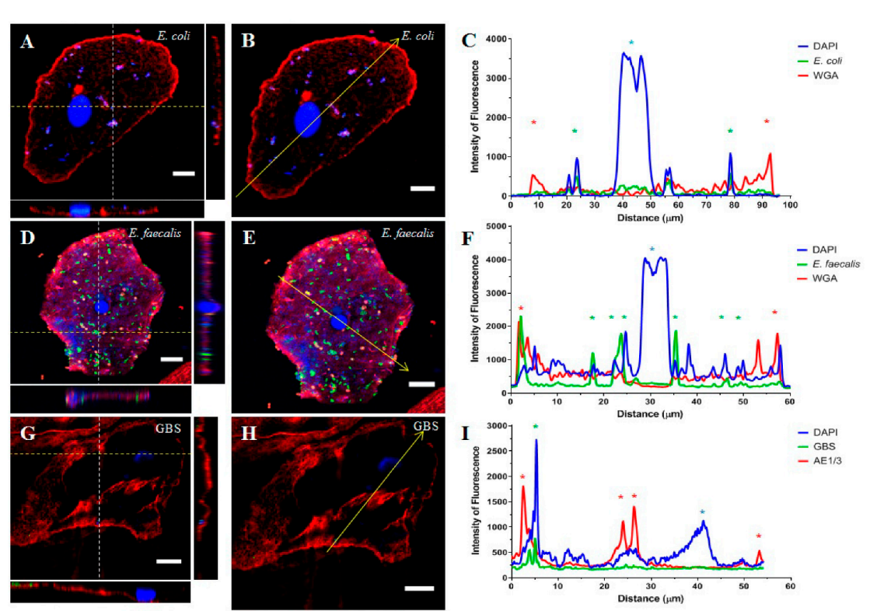
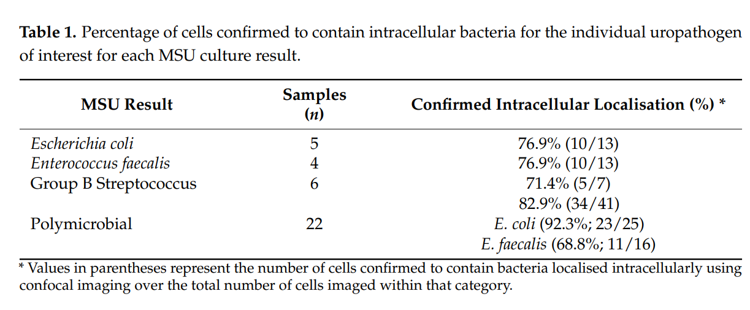
Bladder (cells) Ognenovska et al
Notes:
Ognenovska, S.; Mukerjee, C.; Sanderson-Smith, M.; Moore, K.H.; Mansfield, K.J. Virulence Mechanisms of Common Uropathogens and Their Intracellular Localisation within Urothelial Cells. Pathogens 2022, 11, 926. https:// doi.org/10.3390/pathogens11080926Figure 1. E. coli (A–C), E. faecalis (D–F), and GBS (G–I) invasion of an exfoliated urothelial cell from women with refractory DO. Cells were fluorescently stained and subsequently imaged using confocal microscopy. (A,D,G) Orthogonal views were obtained to visualise the location of all structures relative to the urothelial cell membrane. The white dashed line indicates the sampled YZ section whilst the yellow dashed line indicates the XZ section. (B,E,H) A line was drawn across a slice image occurring mid-way through the Z-stack. The intensity of fluorescence of each stain along the line was measured and depicted as a plot profile (C,F,I). The yellow arrow indicates the line and direction of the plot profile analysis whilst the coloured asterisks denote the objects the line passed through: entry and exit of the urothelial cell membrane (red), confirmed intracellular bacteria (green), and the urothelial cell nuclei (blue). Note, for E. coli (panel (A,B)) and GBS (panel (G,H)), the green staining showing intracellular bacteria was subdued. Although clearly visible when viewed in isolation, when all three channels were viewed together (as shown in the panels) the nuclear stain (blue) overwhelmed the green staining of the bacteria. Scale bars: 10 µm.

Slide 5
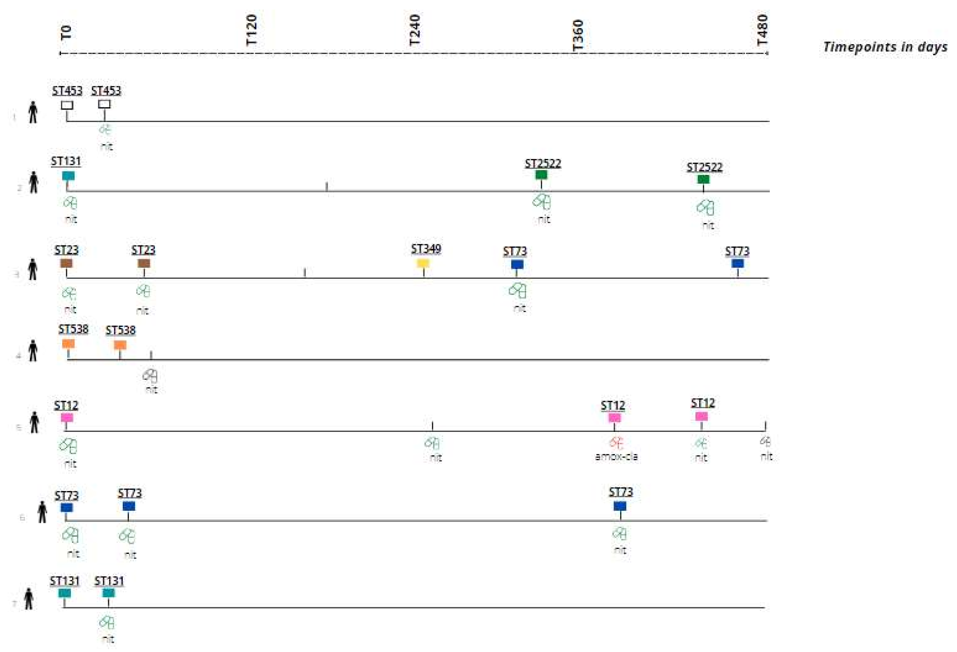
PROGRESS
Notes:
Overview of nursing home residents (7 unique individuals) with recurrent UTI caused by same-strain E. coli identified based on SNP analysis. Box color represents E. coli sequence type identified; the same color reflects the same strain. STxxx represents sequence type. No box indicates: no urine culture result/isolate available. Green pill indicates a susceptible E. coli strain for antibiotic treatment prescribed; red pill indicates resistant E. coli strains for antibiotic treatment prescribed. Black pill indicates antibiotic treatment with lacking susceptibility testing results. amox/cla = amoxicillin–clavulanic acid; nit = nitrofurantoin; ST = sequence type; T0 = day of the index UT.
Introduction: Recurrent urinary tract infections (rUTI) largely contribute to antibiotic use in older adults. Understanding the genetic characteristics of Escherichia coli (E.coli) is needed to identify patients at risk for recurrence. The aim of this study was to obtain a greater understanding of the genetics of E. coli rUTI in nursing home residents. Methods: This is a secondary analysis of a multicenter Dutch nursing home study (PROGRESS). E. coli strains from residents with a suspected UTI and positive urine culture were analyzed using antimicrobial susceptibility testing and whole-genome sequencing (WGS). Same-strain recurrences were identified by single-nucleotide polymorphism (SNP) analysis. Result: In total, 121 E. coli strains were analyzed using WGS, of which 54 belonged to a rUTI episode. One third of E. coli rUTI episodes were caused by the same strain (n = 18, 33.3%). Same-strain recurrence occurred anywhere between 30 and 434 days after the index UTI, caused by sequence types (ST): ST12, ST23, ST73, ST131, ST453, ST538 and ST2522, in seven nursing home residents. In both single UTI and rUTI, antimicrobial resistance rates were low. Conclusion: Recurrent UTI in nursing home residents are caused by same-strain E. coli as well as due to different E. coli strains or other uropathogens. Same-strain recurrence can occur over 400 days after the index UTI, suggesting that some strains have the ability to colonize the bladder or gut for longer periods.

Slide 6

Putative virulence factors (PUFs)

Slide 7
Schreiber et al. Bacterial virulence phenotypes of Escherichia coli and host susceptibility determine risk for urinary tract infections. Sci Transl Med 2017; 9: eaaf1283.
Despite decades of research using model UPEC strains, universal bacterial features that enable E. coli uropathogenesis remain largely undefined.
Carriage of putative urovirulence factors (PUFs) is thought to enhance E. coli uropathogenicity and is used to measure and clinical UPEC strains isolated from different patient populations.
PUFs were identified through their enrichment in UTI isolates when compared to non-UTI associated E. coli.
While numerous sets of PUFs have been used to assess urovirulence and strains with more PUFs are considered more uropathogenic than strains with fewer PUFs, a direct role in pathogenicity remains to be defined for the majority of PUFs.

Slide 8
Spurbeck et al Escherichia coli isolates that carry vat, fyuA, chuA, and yfcV efficiently colonize the urinary tract. Infect Immun 2012; 80: 4115–22.
Extraintestinal Escherichia coli (ExPEC), a heterogeneous group defined by isolation from infections outside the intestinal tract
uropathogenic E. coli (UPEC)
avian-pathogenic E. coli (APEC)
neonatal meningitis E. coli (NMEC)
GENES
Vat = an autotransporter serine protease toxin;
fyuA = yersiniabactin receptor;
chuA = a heme binding protein
yfcV = major subunit of a putative chaperoneusher fimbria
E. coli isolates that encode these four genes are correlated with carriage of a high number of other virulence factors, are able to colonize the bladder in higher numbers than strains lacking these genes & are nearly 10 times more likely to represent UPEC or NMEC strains than fecal commensal strains.
Human intestinal isolates that encode all 4 predictor genes express them during exponential growth in human urine & colonize the bladder in the mouse model of ascending UTI in higher numbers than human commensal strains that do not encode the four predictor genes (P0.02), suggesting that the presence of the predictors correlates with uropathogenic potential.

Slide 9
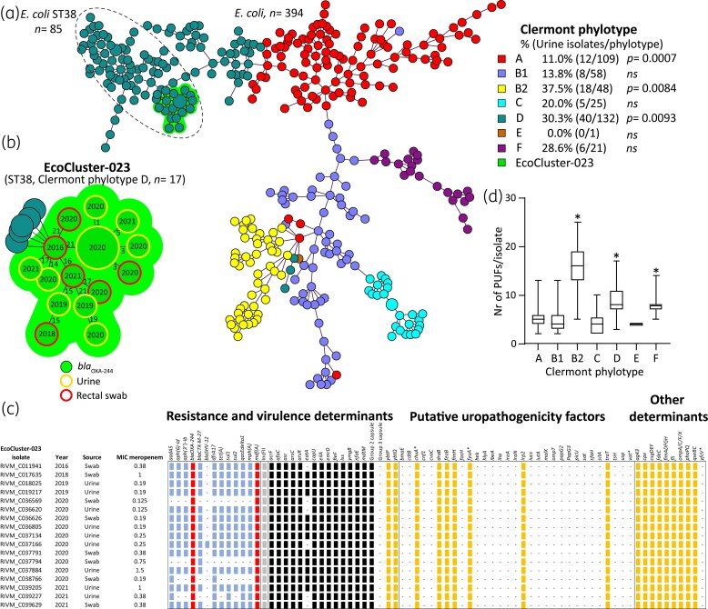
Mulder M, Notermans DW, Wielders CCH, Bos J, Witteveen S, Ganesh VA, Landman F, de Haan A, Schneeberger-van der Linden C, Hendrickx APA. OXA-48–producing uropathogenic Escherichia coli sequence type 127, the Netherlands, 2015–2022. Emerg Infect Dis. 2023 Dec.
Notes:
Figure 1. wgMLST tree of 394 carbapenemase-producing E. coli isolates showing a genetic cluster of OXA-244-producing E. coli ST38. (a) Minimum spanning tree of carbapenemase-producing E. coli from the Dutch national surveillance with EcoCluster-023 indicated with a green halo and Clermont phylotypes in multiple colours.E. coli ST38 isolates are encircled. Inset: percentage of urine-retrieved isolates per Clermont phylotype. Statistical significance is indicated, ns = not significant. (b) Genetic relationship between EcoCluster-023 isolates (marked green) is indicated by allelic differences, each circle represents an isolate and a large circle represents >1 isolate. The year of isolation is marked in the circles. Isolation from urine is indicated in yellow, while rectal swabs are indicated in red. The minimum spanning tree was based on an in-house E. coli wgMLST as described previously. The wgMLST cluster was defined as ≥2 isolates of which the genetic distance was ≤25 alleles (25/4503, ≤0.55% different). (c) Molecular characteristics of EcoCluster-023 isolates. Plasmid-localized antimicrobial resistance (AMR) genes are indicated in blue, chromosomal in red, uropathogenicity factors in yellow, other virulence and AMR determinants in black. Asterisks indicate genes implicated in uropathogenicity from Spurbeck et al. (d) Number of PUFs per isolate plotted per Clermont phylogroup. Kruskal–Wallis non-parametric test was performed using GraphPad Prism 9.0 (P < 0.0001) and statistical significance indicated by an * and in Table S1.

Slide 10
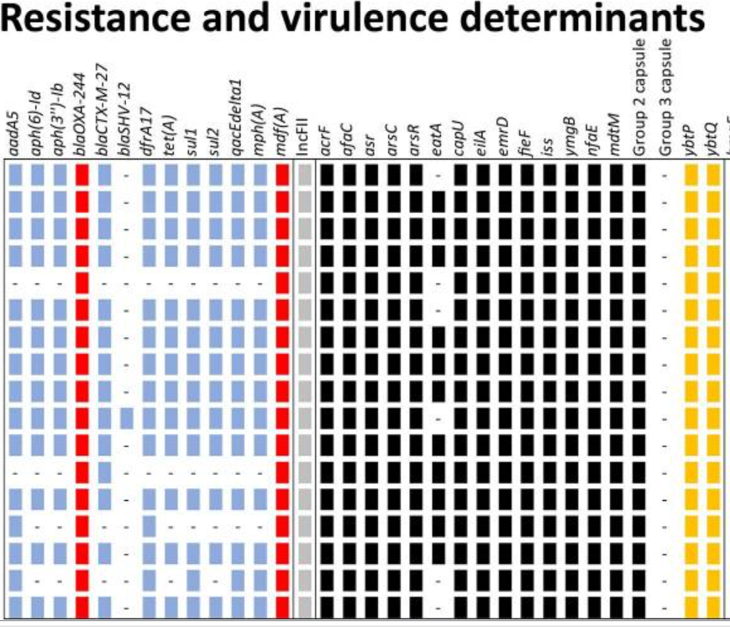
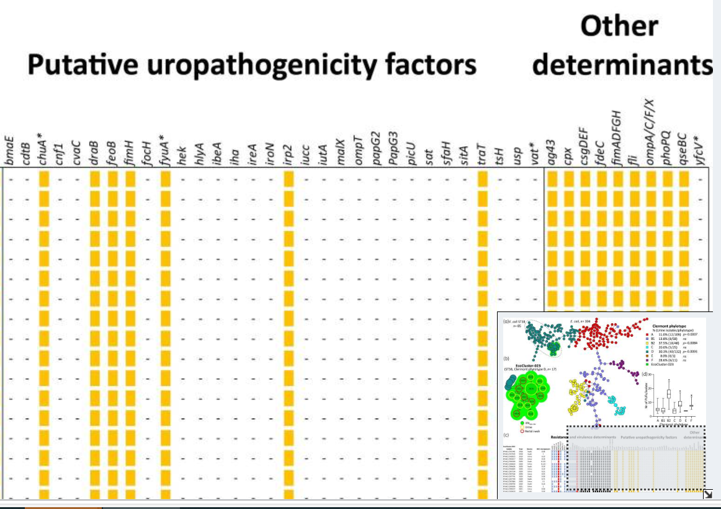
Molecular characteristics of EcoCluster-023 isolates. Plasmid-localized antimicrobial resistance (AMR) genes are indicated in blue, chromosomal in red, uropathogenicity factors in yellow, other virulence and AMR determinants in black. Asterisks indicate genes implicated in uropathogenicity from Spurbeck et al.

Slide 11

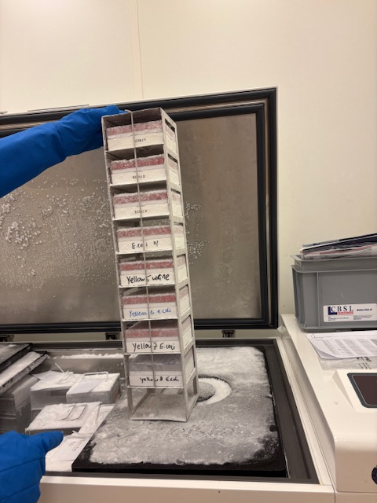
Vandaag

Slide 12

PUF abbreviation |  | Overall, n (%) | UTI group, n (%) | ASB group, n (%)
iha | Nonhemagglutinin adhesin | 10 (22) | 4 (13) | 6 (40)
ireA | Iron-regulated element (siderophore receptor) | 4 (9) | 3 (10) | 1 (7)
iroN | Salmochelin siderophore receptor | 23 (50) | 17 (55) | 6 (40)
irp2 | Yersinia biosynthetic protein | 36 (78) | 23 (74) | 13 (87)
iucc | Aerobactin biosynthetic protein | 14 (30) | 7 (23) | 7 (47)
iutA | Ferric aerobactin receptor | 4 (9) | 3 (10) | 1 (7)
malX | Marker of pathogenicity-associated island | 29 (63) | 19 (61) | 10 (67)
ompT | Outer membrane protein T (protease) | 39 (85) | 25 (81) | 14 (93)
papG2 | P pili adhesin - Pyelonephritis-associated papG variant | 16 (35) | 11 (35) | 5 (33)
PapG3 | P pili adhesin - Cystitis-associated papG variant | 16 (35) | 11 (35) | 5 (33)
picU | Protein involved in Intestinal Colonization - serine protease | 8 (17) | 6 (19) | 2 (13)
sat | Secreted autotransporter toxin | 9 (20) | 4 (13) | 5 (33)
SfaH | S pili adhesin (marker for sfa operon) | 11 (24) | 10 (32) | 1 (7)
sitA | Periplasmic iron transport | 38 (83) | 24 (77) | 14 (93)
traT | Temperature-sensitive hemagglutinin - serine protease | 21 (46) | 13 (42) | 8 (53)
tsH | Surface exclusion (toxin) | 26 (57) | 18 (58) | 8 (53)
usp | Uropathogenic-Specific Protein (bacteriocin) | 30 (65) | 20 (65) | 10 (67)
vat | Vacolating autotransporter - serine protease (toxin) | 26 (57) | 18 (58) | 8 (53)
PUF abbreviation | PUF description | Overall, n (%) | UTI group, n (%) | ASB group, n (%)
bmaE | Blood group M-specific adhesin | 0 (0) | 0 (0) | 0 (0)
cdtB | Cytolethal distending toxin | 1 (2) | 1 (3) | 0 (0)
chuA | Heme binding outer membrane | 37 (80) | 24 (77) | 13 (87)
cnf1 | Cytotoxic necrotizing factor 1 (toxin) | 12 (26) | 10 (32) | 2 (13)
cvaC | Colicin V | 6 (13) | 5 (16) | 1 (7)
draB | Dr antigen-specific adhesin | 0 (0) | 0 (0) | 0 (0)
feoB | Ferrous iron transport | 46 (100) | 31 (100) | 15 (100)
fimH | D-mannose–specific adhesin, lining the superficial bladder epithelium. | 46 (100) | 31 (100) | 15 (100)
focH | F1C pili adhesin | 12 (26) | 9 (29) | 3 (20)
fyuA | Yersiniabactin siderophore receptor | 36 (78) | 23 (74) | 13 (87)
hek | Auto-aggregating adhesin and invasin | 17 (37) | 13 (42) | 4 (27)
hlyA | a-Hemolysin (toxin) | 14 (30) | 11 (35) | 3(20)
ibeA | Invasion of brain endothelium | 10 (22) | 7 (23) | 3 (20)
iha | Nonhemagglutinin adhesin | 10 (22) | 4 (13) | 6 (40)

Slide 13
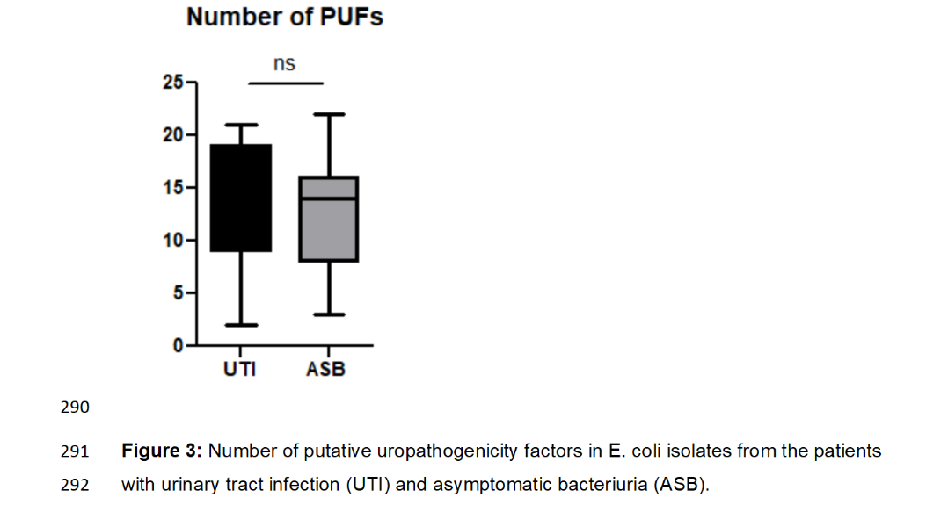
SENIOR
Notes:
Introduction: Diagnosing urinary tract infection (UTI) in older women is complicated due to the high prevalence of asymptomatic bacteriuria (ASB). Our primary aim was to evaluate whether pathogen-related factors differ between older women with UTI and ASB. Additionally, we aimed to gain more insight into the persistence of Escherichia coli in ASB and the concordance between genotypic and phenotypic resistance of these clinical stains.
Methods: In this exploratory study, stored E. coli isolates of 46 participants of a larger case-control study were analysed. This study included women aged ³ 65 years with UTI (³ 2 new-onset lower urinary tract symptoms, pyuria, and bacteriuria) or ASB (E. coli ³ 104 CFU/mL in 2 consecutive samples) from the community and long-term care facilities. Whole-genome sequencing was used to identify previously described putative urinary factors (PUFs), antimicrobial resistance genes, and to determine multilocus sequence typing (MLST) sequence type (ST) and Clermont phylotype. Phenotypic susceptibility was tested according to EUCAST standards.
Results: A total of 31 isolates from UTI patients and 30 paired isolates from 15 ASB patients were analysed. We found no significant differences in ST types, the number of PUFs, or Clermont phylotypes between UTI and ASB isolates. All patients in the ASB group carried genetically similar E. coli isolates in two consecutive samples (obtained within 2-4 weeks). Antimicrobial resistance in the isolates was generally low, but phenotypic resistance to beta-lactam antibiotics, aminoglycosides, and sulfamethoxazole-trimethoprim could be well inferred from the presence of specific resistance genes.
Discussion: Our study showed that patients with ASB persistently carried similar E. coli isolates. We could not demonstrate that isolates from the UTI group were different or had more virulence factors than those from the ASB group. Despite the limited sample size, our findings suggest that host susceptibility may play a role in the older female population.

Slide 14
Bedankt

